Slide 1
CSE 2251
DATA COMMUNICATION AND COMPUTER NETWORKS
T1. Behrouz A. Forouzan, “Data Communications and Networking with TCP/IP Protocol Suite”, 6th Edition, Tata McGraw-Hill, 2021
1

Slide 2
Module-1.1
DATA COMMUNICATION AND COMPUTER NETWORKS
CSE 2251
Data Communication and Network Model
1

Slide 3
DATA COMMUNICATION
Data communications and networking are changing today's world. Why wait for a week for some report from UK to arrive by post where you can receive instantaneously through computer networks?
The term telecommunication means communication at a distance.
The word data refers to information presented in whatever form is agreed upon by the parties creating and using the data.
Data communications are the exchange of data between two devices via some form of transmission medium such as a wire cable.

Slide 4


CHARACTERISTICS OF DC
The four fundamental characteristics of data communications are:-
Delivery: The system must deliver data to the correct destination. Data must be received by the intended device or user and only by that device or user.
Accuracy: The system must deliver the data accurately. Data that have been altered in transmission and left uncorrected are unusable.

Slide 5

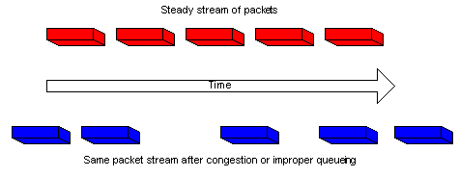
CHARACTERISTICS OF DC
Timeliness: The system must deliver data in a timely manner.Data delivered late are useless. In the case of video and audio, timely delivery means delivering data as they are produced, in the same order that they are produced, and without significant delay.
Jitter: Jitter refers to the variation in the packet arrival time. It is the uneven delay in the delivery of audio or video packets. For example, let us assume that video packets are sent every 30ms. If some of the packets arrive with 30-ms delay and others with 40-ms delay, an uneven quality in the video is the result.

Slide 6
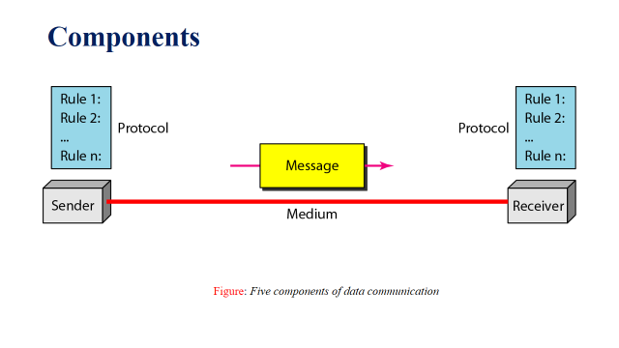
COMPONENTS OF DC

Slide 7
COMPONENTS OF DC
The five components of data communications are:
Message: The message is the information (data) to be communicated. Popular forms of information include text, numbers, pictures, audio, and video.
Sender: The sender is the device that sends the data message. It can be a computer, workstation, telephone handset, mobile, and so on.
Receiver: The receiver is the device that receives the message. It can be a computer, workstation, telephone handset, television, and so on.
Transmission medium: The transmission medium is the physical path by which a message travels from sender to receiver. Some examples of transmission media include twisted-pair wire, coaxial cable, fibre-optic cable, and radio waves.
Protocol: A protocol is a set of rules that govern data communications. It represents an agreement between the communicating devices. Without a protocol, two devices may be connected but not communicating.

Slide 8
DATA REPRESENTATION
Information today comes in different forms such as :
Text
Numbers
Images
Audio
Video

Slide 9
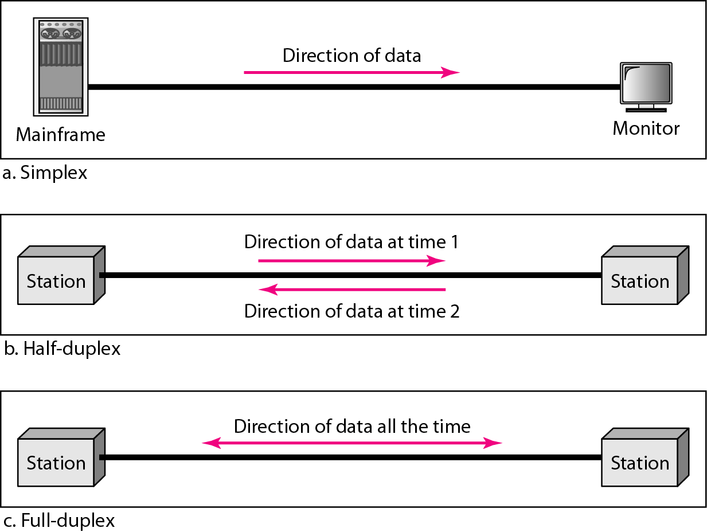
DATA FLOW (SIMPLEX, HALF-DUPLEX, AND FULL-DUPLEX)

Slide 10
DATA FLOW(CNTD)
Communication between two devices can be simplex, half-duplex, or full-duplex as shown in figure above.
Simplex
In simplex mode, the communication is unidirectional, as on a one-way street.Only one of the two devices on a link can transmit; the other can only receive.
Example:Keyboards and traditional monitors
Half-Duplex
In half-duplex mode, each station can both transmit and receive, but not at the same time. When one device is sending, the other can only receive, and vice versa.
In a half-duplex transmission, the entire capacity of a channel is taken over by whichever of the two devices is transmitting at the time.
Example: Walkie-Talkie

Slide 11
DATA FLOW(CNTD)
Full-Duplex
In full-duplex mode (also called duplex), both stations can transmit and receive simultaneously.
In full-duplex mode, signals going in one direction share the capacity of the link with signals going in the other direction.
Example: Telephone

Slide 12
INTRODUCTION TO NETWORKS
A network is a set of devices (often referred to as nodes) connected by communication links.
A node can be a computer, printer, or any other device capable of sending and/or receiving data generated by other nodes on the network.
A link can be a cable, air, optical fiber, or any medium which can transport a signal carrying information.

Slide 13
NETWORK CRITERIA
Performance
  Depends on Network Elements
  Measured in terms of Delay and Throughput
Reliability
  Failure rate of network components
  Measured in terms of availability/robustness
Security
  Data protection against corruption/loss of data due to:
      Errors
      Malicious users

Slide 14
PHYSICAL STRUCTURES
Type of Connection
  Point to Point - single transmitter and receiver
  Multipoint - multiple recipients of single transmission
Physical Topology
  Connection of devices
  Type of transmission - unicast, multicast, broadcast

Slide 15
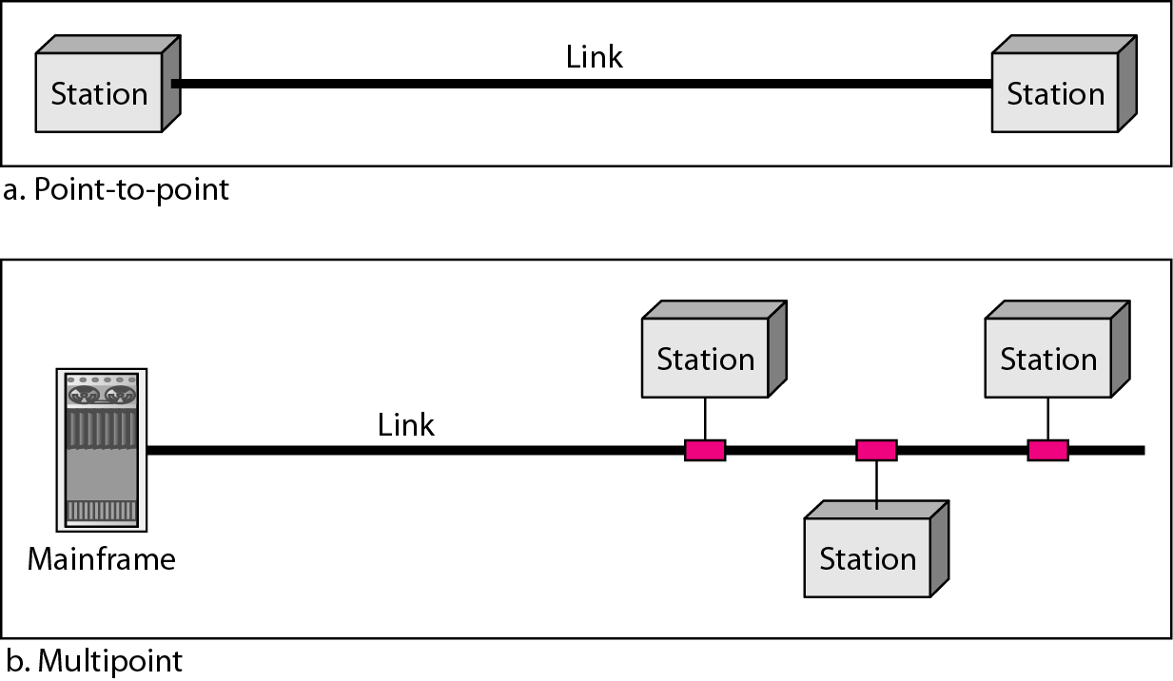
Types of connections: point-to-point and multipoint

Slide 16
NETWORK TOPOLOGY
Network Topology is the schematic description of a network arrangement, connecting various nodes(sender and receiver) through lines of connection.

Slide 17
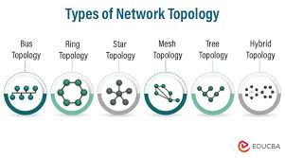
TYPES OF NETWORK TOPOLOGIES
Bus Topology
Ring Topology
Star Topology
Mesh Topology
Tree Topology
Hybrid Topology

Slide 18
BUS TOPOLOGY
Bus topology is a network type in which every computer and network device connected to single cable. When it has exactly two endpoints, then it is called Linear Bus topology.
Features of Bus Topology
It transmits data only in one direction.
Every device is connected to a single cable

Slide 19
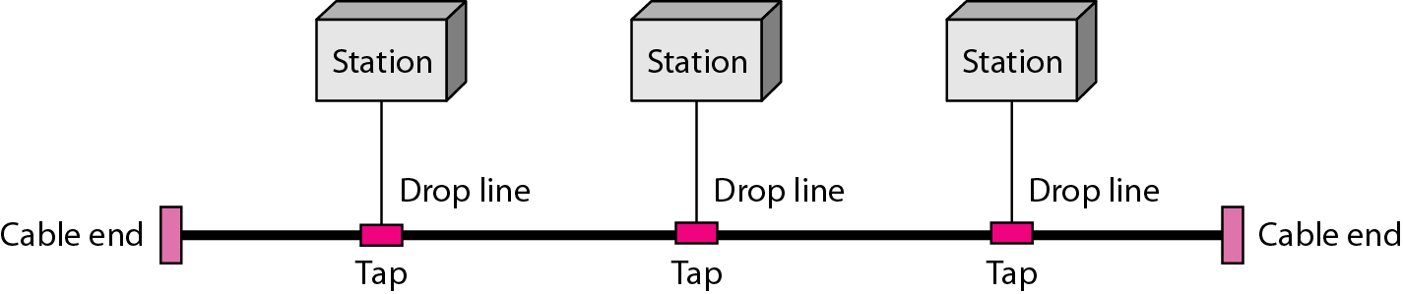
Bus Topology

Slide 20
Advantages of Bus Topology
  It is cost effective and used in small networks.
  It is easy to understand.
  Easy to expand joining two cables together.
  Cable required is least compared to other network topology.
Disadvantages of Bus Topology
  Cables fails then whole network fails.
  If network traffic is heavy or nodes are more the performance of the network decreases.
  Cable has a limited length.
  It is slower than the ring topology.

Slide 21
RING TOPOLOGY
It is called ring topology because it forms a ring as each computer is connected to another computer, with the last one connected to the first. Exactly two neighbors for each device.
Features of Ring Topology
The transmission is unidirectional
Data is transferred in a sequential manner that is bit by bit. Data transmitted, has to pass through each node of the network, till the destination node.

Slide 22
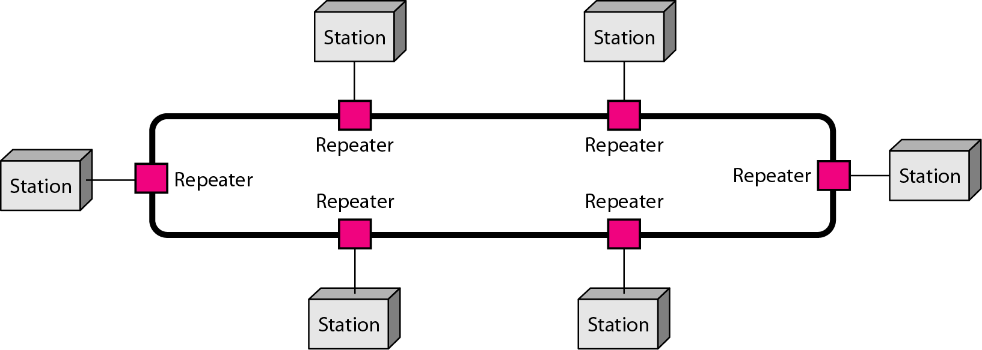
Ring Topology

Slide 23
Advantages of Ring Topology
Transmitting network is not affected by high traffic or by adding more nodes, as only the nodes having tokens can transmit data.
Cheap to install and expand
Disadvantages of Ring Topology
Troubleshooting is difficult in ring topology.
Adding or deleting the computers disturbs the network activity.
Failure of one computer disturbs the whole network.

Slide 24
STAR TOPOLOGY
In this type of topology all the computers are connected to a single hub through a cable. This hub is the central node and all others nodes are connected to the central node.
Features of Star Topology
Every node has its own dedicated connection to the hub.
Hub acts as a repeater for data flow.
Can be used with twisted pair, Optical Fiber or coaxial cable.

Slide 25
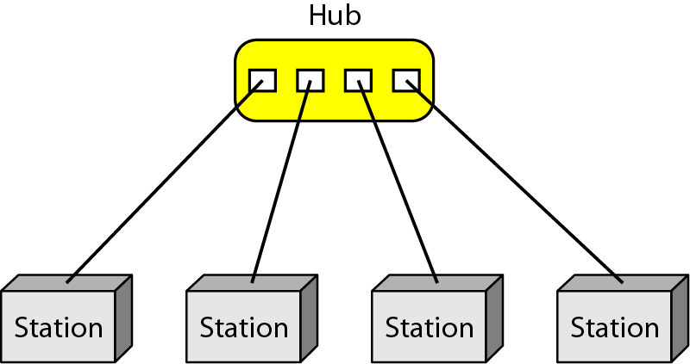
Star Topology

Slide 26
Advantages of Star Topology
Fast performance with few nodes and low network traffic.
Hub can be upgraded easily.
Easy to troubleshoot.
Easy to setup and modify.
Only that node is affected which has failed, rest of the nodes can work smoothly.
Disadvantages of Star Topology
Cost of installation is high.
Expensive to use.
If the hub fails then the whole network is stopped because all the nodes depend on the hub.
Performance is based on the hub that is it depends on its capacity

Slide 27
MESH TOPOLOGY
It is a point-to-point connection to other nodes or devices. All the network nodes are connected to each other. Mesh has n(n-1)/2 physical channels to link n devices.
Features of Mesh Topology
Fully connected
Robust.
Not flexible.

Slide 28
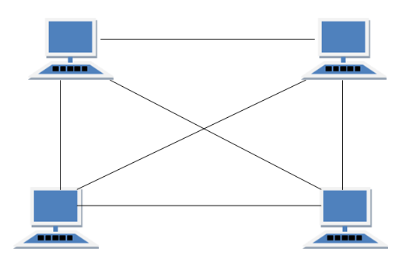
Mesh Topology

Slide 29
Advantages of Mesh Topology
Each connection can carry its own data load.
It is robust.
Fault is diagnosed easily.
Provides security and privacy.
Disadvantages of Mesh Topology
Installation and configuration is difficult.
Cabling cost is more.
Bulk wiring is required.

Slide 30
TREE TOPOLOGY
It has a root node and all other nodes are connected to it forming a hierarchy. It is also called hierarchical topology. It should at least have three levels to the hierarchy.
Features of Tree Topology
Used in Wide Area Network.
Expansion of nodes is possible and easy.

Slide 31
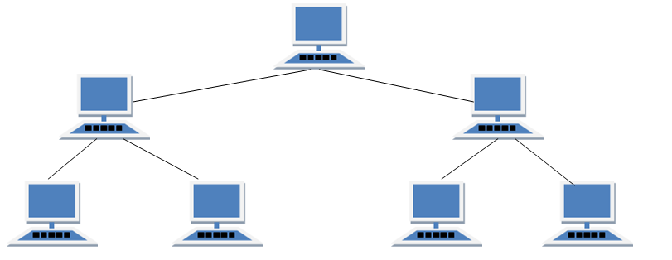
Tree Topology

Slide 32
Advantages of Tree Topology
Extension of bus and star topologies.
Expansion of nodes is possible and easy.
Easily managed and maintained.
Error detection is easily done.
Disadvantages of Tree Topology
Heavily cabled.
Costly.
If more nodes are added maintenance is difficult.
Central hub fails, network fails.

Slide 33
HYBRID TOPOLOGY
It is different type of topology which is a mixture of two or more topologies.
For example if in an office in one department ring topology is used and in another star topology is used, connecting these topologies will result in Hybrid Topology (ring topology and star topology).
Features of Hybrid Topology
It is a combination of two or topologies
Inherits the advantages and disadvantages of the topologies included

Slide 34
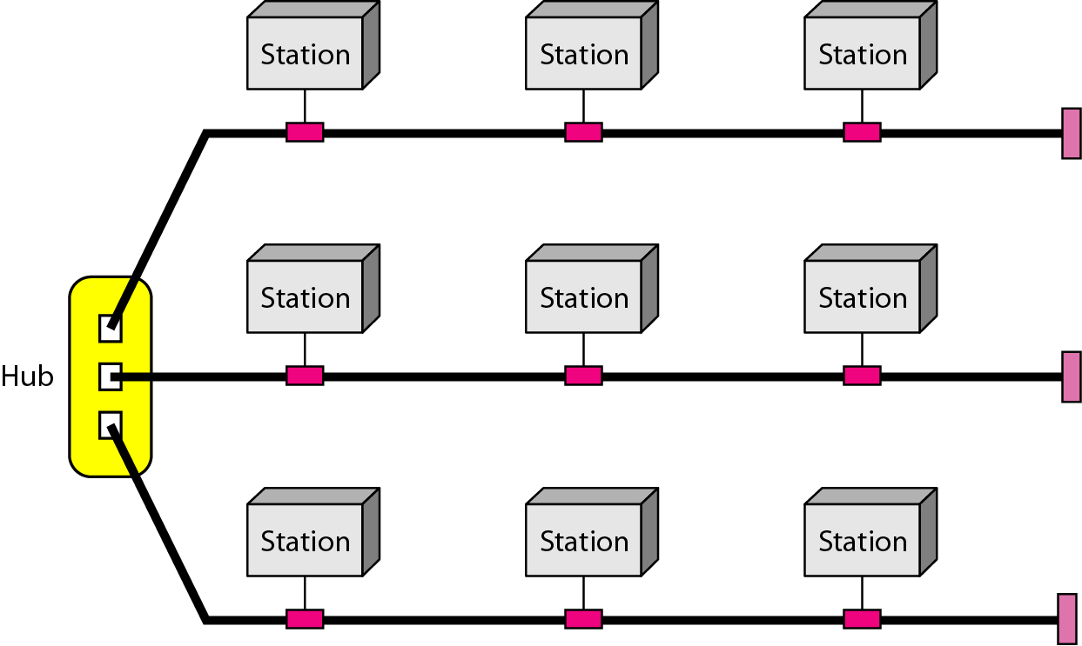
Hybrid Topology

Slide 35
Advantages of Hybrid Topology
Reliable as Error detecting and trouble shooting is easy.
Effective
Scalable as size can be increased easily.
Flexible
Disadvantages of Hybrid Topology
Complex in design.
Costly

Slide 36
PROTOCOLS
A protocol is synonymous with rule. It consists of a set of rules that govern data communications. It determines what is communicated, how it is communicated and when it is communicated. The key elements of a protocol are syntax, semantics and timing.

Slide 37
ELEMENTS OF A PROTOCOL
Syntax
  Structure or format of the data
  Indicates how to read the bits - field delineation
Semantics
  Interprets the meaning of the bits
  Knows which fields define what action
Timing
  When data should be sent and what
  Speed at which data should be sent or speed at which it is being received.

Slide 38
NETWORK MODEL

Slide 39
LAYERED TASKS
Computer networks are complex systems
  Tasks involve varieties of hardware and software components, and protocols
Networking task is divided into several subtasks, or layers.
WHY LAYERING?
Networks are complex!
We need a way to organize the structure of network functionalities and to reduce the design complexities
Benefits of layering
  Interoperability
  Reuse
  Hiding underlying details

Slide 40
REAL WORLD EXAMPLE
Communication between managers of two companies
Communicate

Slide 41
LOGICAL CONNECTION
Communication takes place through many layers
Logical communication
Secretary:
reads and reports
the message
Secretary:
types a letter
Delivery boy:
drops the letter
Delivery boy:
takes the letter
Postal truck
Post office:
Processes and routes the letter

Slide 42
LAYER MODEL
Layer N uses services provided by Layer N-1
HOST A
HOST B
Logical
communication path
Layer N
Layer N
Layer N protocol
Using
services
Providing
services
Layer N-1
Layer N-1
Layer N-2
Layer N-2
Virtual Communication System

Slide 43
NETWORK MODEL
Network models are responsible for establishing a connection among the sender and receiver and transmitting the data.
There are two computer network models on which data communication process relies :
  TCP/IP Model
  ISO/OSI Model

Slide 44
TCP/IP MODEL
The TCP/IP model was developed prior to the OSI model.
The TCP/IP model is not exactly similar to the OSI model.
The TCP/IP model consists of five layers: the application layer, transport layer, network layer, data link layer and physical layer.
The first four layers provide physical standards, network interface, internetworking, and transport functions that correspond to the first four layers of the OSI model .
TCP/IP is a hierarchical protocol made up of interactive modules, and each of them provides specific functionality.

Slide 45
TCP/IP OR INTERNET LAYER MODEL
The Internet Protocol Stack
User
Application Layer
Transport Layer
Network Layer
Data Link Layer
Physical Layer
Software
Hardware
Transmission
Medium

Slide 46
TCP/IP Model: the Internet model
Each layer relies on services from layer below
Each layer exports services to layer above
Interface between layers defines interaction
  Hides implementation details
  Layers can change without disturbing other layers
5
Application
Application
4
Transport
Transport
3
Network
Network
Network
2
Data link
Data link
Data link
1
Physical
Physical
Physical

Slide 47
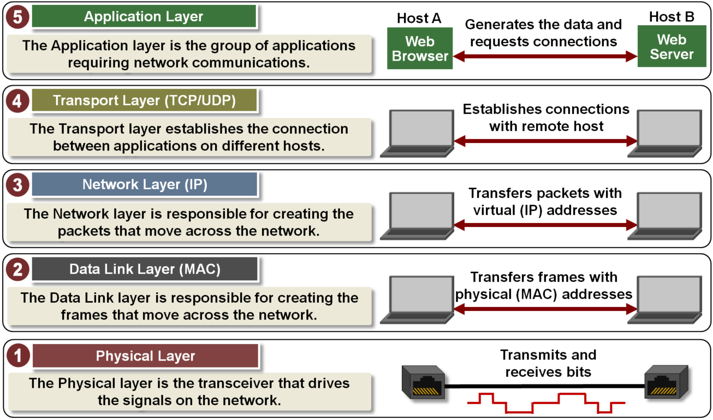

Slide 48
APPLICATION LAYER
It is the topmost layer in the TCP/IP model.
It is responsible for handling high-level protocols, issues of representation.
This layer allows the user to interact with the application.
It facilitates the user to use the services of the network.
It is used to develop network-based applications.
It provides user services like user login, naming network devices, formatting messages, and e-mails, transfer of files etc.
When one application layer protocol wants to communicate with another application layer, it forwards its data to the transport layer.

Slide 49


APPLICATION LAYER
The only layer to interact with user
Data
Logical communication
Data
Application
Layer
SMTP
HTTP
FTP
SMTP
HTTP
FTP
Data
H5
Data
H5
to Transport
from Transport
Responsible for providing services to the user

Slide 50
TRANSPORT LAYER
The transport layer is a 4th layer from the top.
It is responsible for end to end data transmission service using connection oriented or either through connection-less protocols.
TCP and UDP are two transport layer protocols that provide a different set of services to the network layer.
It provide multiplexing/demultiplexing service.
It also provides other services such as reliable data transfer, bandwidth guarantees, and delay guarantees,flow control.

Slide 51
TRANSPORT LAYER
Responsible for delivery of a message
from one process to another
Duties/services
  Service-point addressing/Port Address
  Segmentation and reassembly
  Connection control
  Flow control (end-to-end)
  Error control (end-to-end)

Slide 52
Transport Layer Services
Segmentation : Large data is divided into smaller segments at the senders end and then these smaller segments are recombined in exact format before it is received at receivers end.
Error Control : Distortion, Un-delivery of data packets and noise in data packets results in error and this is prevented using Data Link and this feature is called Error Control.
Flow Control : Transport-Layer ensures that faster data transmission and slow data absorption or slow data transmission and faster data absorption must not occur.
Transport-Layer performs Multiplexing & De-multiplexing.
Connection Control: Connection oriented service using TCP(Transmission Control Protocol) Protocol & Connection less service using UDP(User Data-gram Protocol) Protocol are performed by transport layer.

Slide 53
Transport Layer
Process
Process
…
Process
Process
…
PORT #
PORT #
Data
Data
Transport
Layer
Data₁
H4
Data₂
H4
Data₃
H4
Data₁
H4
Data₂
H4
Data₃
H4
(segments)
to Network
from Network

Slide 54
NETWORK LAYER
Responsible for the delivery of packets
from the original source to the destination
Duties/services
  Logical addressing
  Routing

Slide 55
NETWORK LAYER
from Transport
to Transport
Data
Data
Network
Layer
Data
H3
Data
H3
(packet)
to Data Link
from Data Link

Slide 56
DATA LINK LAYER
Framing: The data link layer divides the stream of bits received from the network layer into manageable data units called frames.
Physical addressing: If frames are to be distributed to different systems on the network, the data link layer adds a header to the frame to define the sender and/or receiver of the frame. If the frame is intended for a system outside the sender's network, the receiver address is the address of the device that connects the network to the next one.
Flow control (hop-to-hop): A receiving node can receive the frames at a faster rate than it can process the frame. Without flow control, the receiver's buffer can overflow, and frames can get lost. To overcome this problem, the data link layer uses the flow control to prevent the sending node on one side of the link from overwhelming the receiving node on another side of the link.
Error control (hop-to-hop):The data link layer adds reliability to the physical layer by adding mechanisms to detect and retransmit damaged or lost frames. It also uses a mechanism to recognize duplicate frames. Error control is normally achieved through a trailer added to the end of the frame.
Access control:. When two or more devices are connected to the same link, data link layer protocols are necessary to determine which device has control over the link at any given time.

Slide 57
DATA LINK LAYER
from Network
to Network
Data
Data
Data Link
Layer
T2
Data
H2
T2
Data
H2
(frame)
to Physical
from Physical
Responsible for transmitting frames
from one hop (node) to the next

Slide 58
PHYSICAL LAYER
The physical layer is responsible for movements of individual bits from one hop (node) to the next
Physical Layer is the bottom-most layer.
It is associated with the electrical, mechanical and transmission media .
Physical layer deals with all the physical devices that can be used for data communication.

Slide 59
PHYSICAL LAYER
from Data Link
to Data Link
Data
Data
Physical
Layer
01001011
01001011
(bits)
Transmission medium

Slide 60
Physical Layer Functions
Physical characteristics of interfaces and medium
Representation of bits: Data consists of a stream of bits (sequence of 0s or 1s) with no interpretation.
Data rate: The number of bits sent per second.
Synchronization of bits: the sender and the receiver clocks must be synchronized.
Line configuration: Point to Point or Multipoint
Physical topology: Bus/ Star/Mesh…
Transmission mode: Simplex/Half/Full

Slide 61

INTERNET MODEL
sender
router
router
receiver
Application
Transport
Network
Data Link
Physical
Application
Transport
Network
Data Link
Physical
Network
Network
D.L.
D.L.
D.L.
D.L.
P.L.
P.L.
P.L.
P.L.
Transmission medium

Slide 62
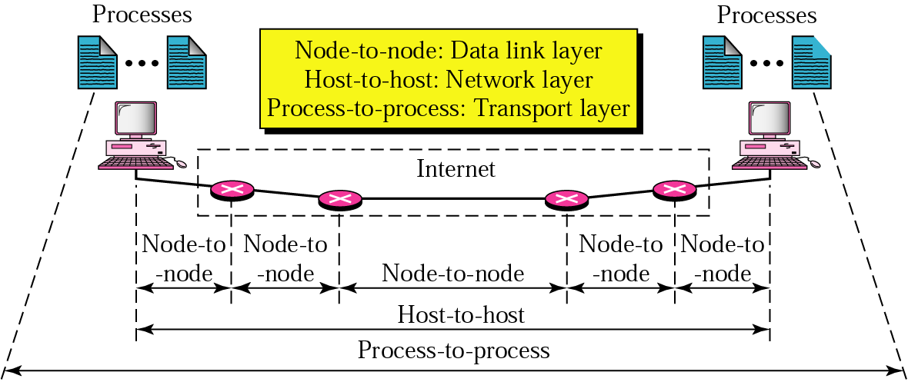
INTERNET MODEL

Slide 63
INTERNET PROTOCOL SUITE
Layer | Protocols
Application | HTTP, FTP, Telnet, SMTP, ...
Transport | TCP, UDP, SCTP, ...
Network | IP (IPv4), IPv6, ICMP, IGMP, ...
Data Link | Ethernet, Wi-Fi, PPP, ...
Physical | RS-232, DSL, 10Base-T, ...

Slide 64
OSI MODEL
OSI stands for Open System Interconnection.
Before networks came into existence, computers could only communicate from the same manufacturers.
OSI was designed by ISO (International Organization for Standardization) in late 1970’s.
To break this barrier so that Computers from different manufacturer could communicate with each other.
OSI is a “Layered Approach”, which is a logical representation of how Data Communication should occur.

Slide 65
OSI Model
User
7.Application Layer
6.Presentation Layer
5.Session Layer
4.Transport Layer
3.Network Layer
2.Data Link Layer
1.Physical Layer
OSI has 7 different layers
Two new layers is added
  Presentation Layer
  Session Layer
It is divided into two groups,
  Top 3 layers defines how application within end stations will communicate with each other and with the user (Software Layer).
  Bottom 4 layers defines how actually data is transferred (Hardware Layer).
Transmission
Medium

Slide 66
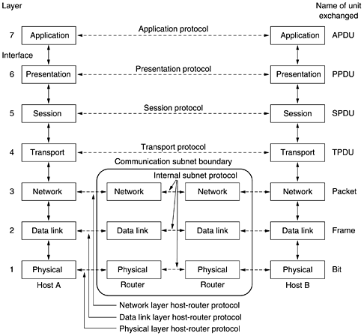
The OSI Reference Model

Slide 67
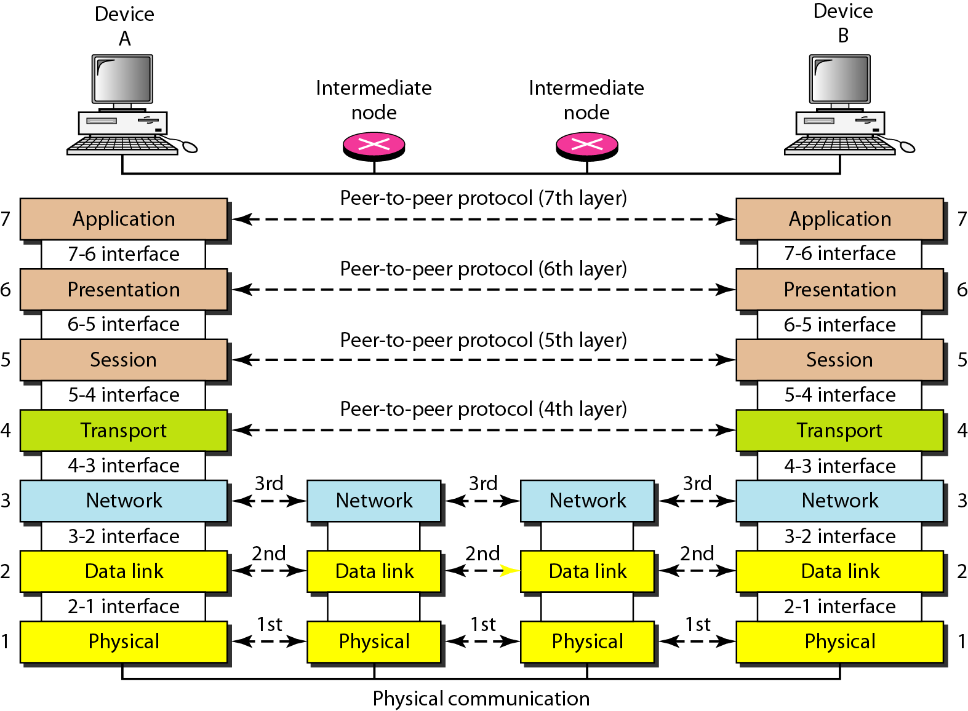
The interaction between layers in the OSI model

Slide 68
SESSION LAYER
This layer is responsible for establishment of connection, maintenance of sessions, authentication and also ensures security.
Duties/services
  Dialog Controller :
    Allows the two processes to establish, use and terminate a connection.
    Communication in half-duplex or full-duplex.
  Synchronization :
    allows a process to add checkpoints
    data is re-synchronized
    Session recovery

Slide 69
PRESENTATION LAYER
A Presentation layer is mainly concerned with the syntax and semantics of the information exchanged between the two systems.
It acts as a data translator for a network.
This layer is a part of the operating system that converts the data from one presentation format to another format.
The Presentation layer is also known as the syntax layer.

Slide 70
PRESENTATION LAYER FUNCTIONS
Duties/services
  Data translation: For example, ASCII to EBCDIC.
  Encryption/Decryption
  Compression: Reduces the number of bits that need to be transmitted on the network.

Slide 71














OSI LAYERS IN REAL WORLD
7.Manager
Handwrites
a message
Reads the
message
Prepares
final version
Summarizes or
translates letter
6.Assistant
Provides address
and packs letter
Opens letter
5.Secretary
Delivers letter
to post office
Withdraws letter
from mailbox
4.Driver
Checks address
and sorts letter
Checks address
and sorts letter
3.Postal staff
Packs letters
for certain directions
Unpacks
packages
2.Postal staff
Loads on truck
Unloads
from truck
1.Postal staff
transmission medium
Pictures from Wikipedia

Slide 72
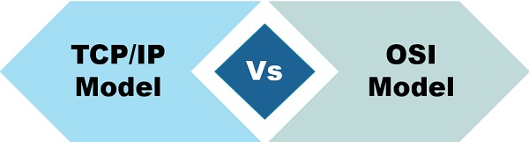
OSI | TCP/IP
It is developed by ISO (International Standard Organization) | It is developed by ARPANET (Advanced Research Project Agency Network).
OSI refers to Open Systems Interconnection. | TCP refers to Transmission Control Protocol.
Session and presentation layers are a part of the OSI model. | There is no session and presentation layer in the TCP model.
OSI is less reliable | TCP/IP is more reliable

Slide 73
END OF MODULE 1.1

